Slide 1







TECHNOLOGY TREND ANALYSIS
Romeo Jeff Fredson
06-19-2021

Slide 2



OUTLINE
Executive Summary
Introduction
Methodology
Results
Visualization – Charts
Dashboard
Discussion
Findings & Implications
Conclusion
Appendix

Slide 3

EXECUTIVE SUMMARY
Current Technology Usage Trend
Language
Database
Platform
Web frame
Future Technology Trend
Language
Database
Platform
Web frame
Demographics Survey
Country & Gender Difference

Slide 4

INTRODUCTION
Analyze technology trend in software and web development amongst developers around the world
Purpose of this Analysis
Identify the top programming languages, database, platform and web frame skills in demand
Identify skill requirements for future
Identify human resource gap in the industry
Audience for this Presentation
Business/Industry Leaders
Programmers/Developers
Students(Computer Science)

Slide 5

METHODOLOGY
Data Collection (Sources)
Stack overflow developer 2019 survey
GitHub job postings
Programming languages annual salary
Data Wrangling
Data Exploration
Data Cleaning
Data Visualization
Python matplotlib & turtle
IBM Cognos
Presentation

Slide 6
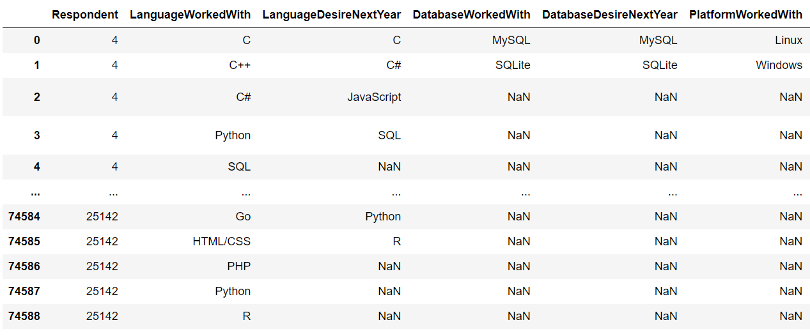
RESULTS

Slide 7
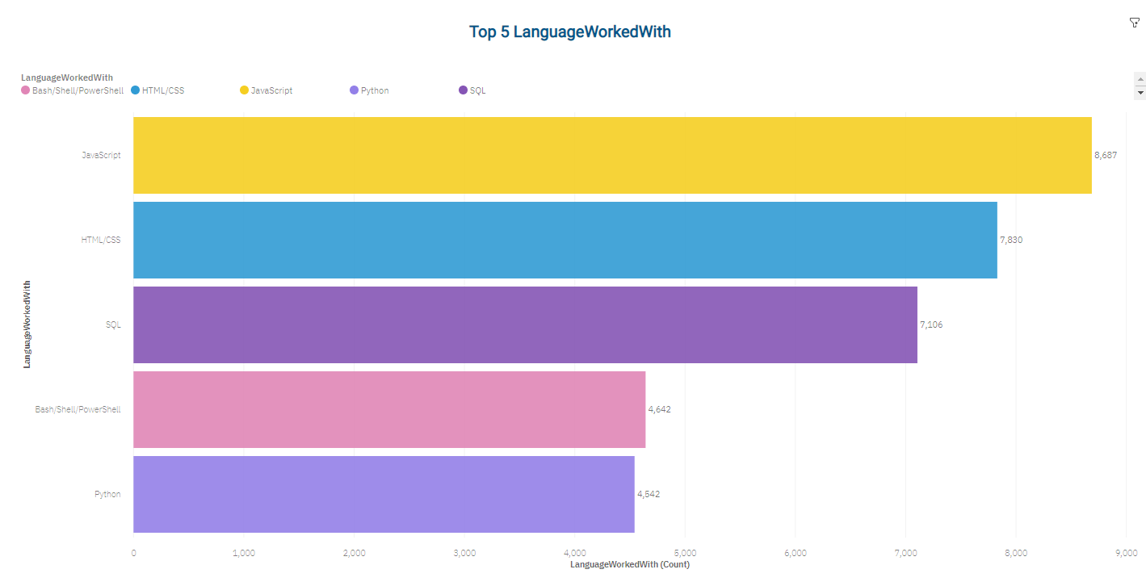
PROGRAMMING LANGUAGE TRENDS
Current Year
< Bar chart of top 5 programming languages for the next year goes here.>

Slide 8
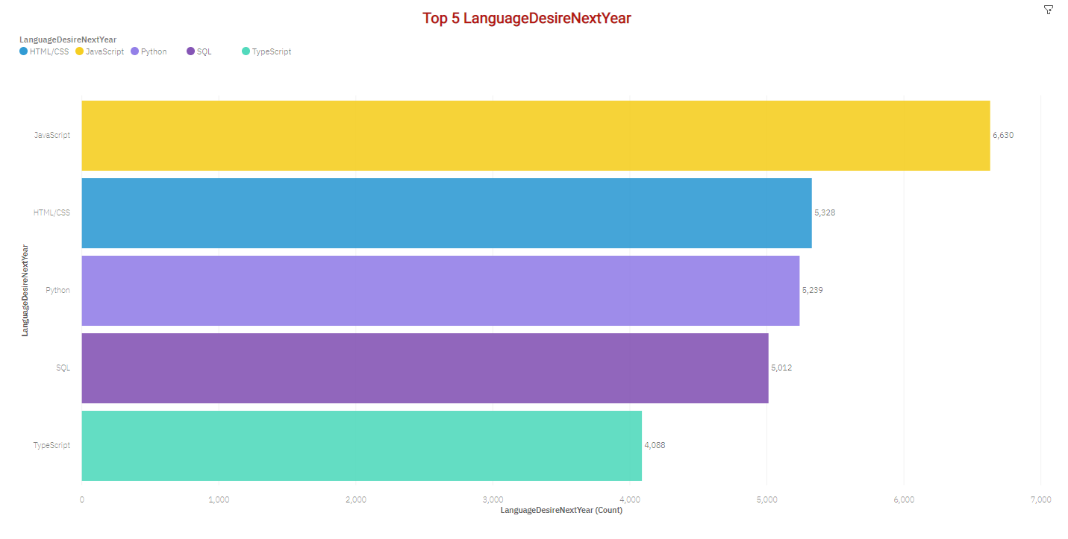
PROGRAMMING LANGUAGE TRENDS
Next Year

Slide 9
PROGRAMMING LANGUAGE TRENDS - FINDINGS & IMPLICATIONS
Findings
JavaScript is top trending language in the world
Python and TypeScript are becoming more and more popular
HTML/CSS and SQL still has great portion in language usage trend
Implications
Web developments and Web developers are still in high demands
JavaScript and TypeScript are crucial to learn for developers
Python is the new trending language, especially popular in AI fields

Slide 10
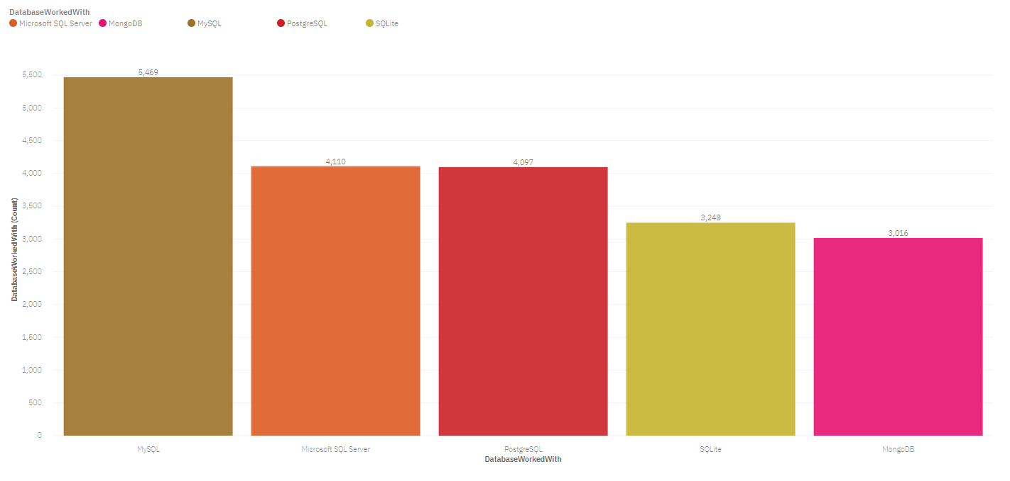
DATABASE TRENDS
Current Year
Next Year
< Bar chart of top 5 databases for the current year goes here >
< Bar chart of top 5 databases for the next year goes here.>

Slide 11
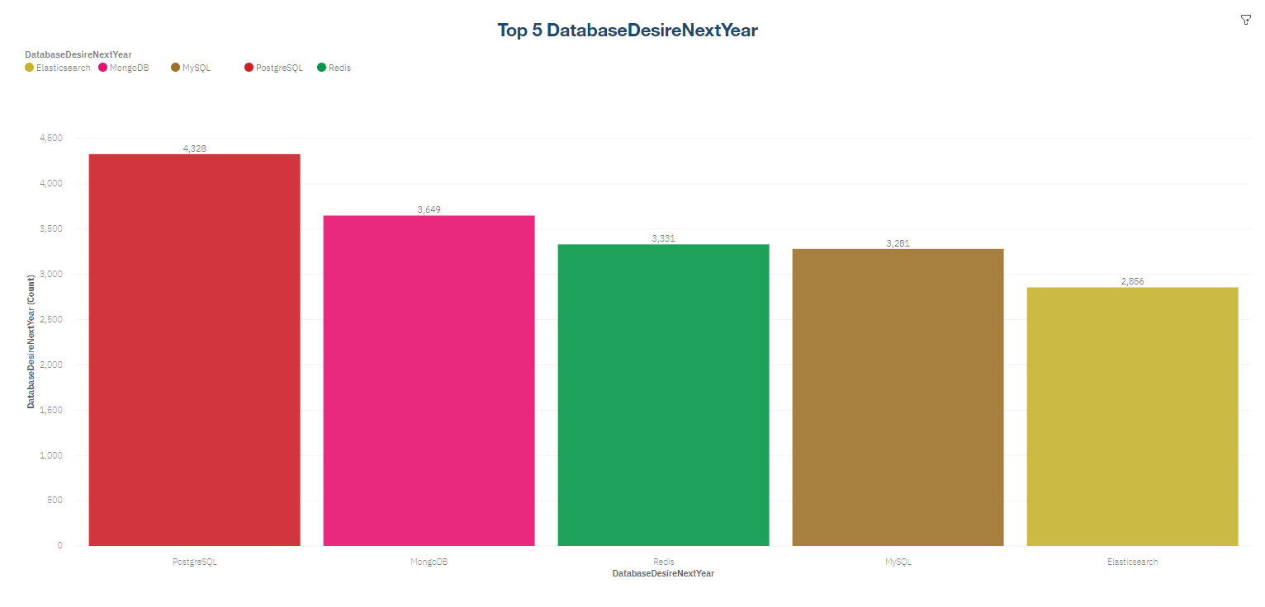
DATABASE TRENDS
Next Year
< Bar chart of top 5 databases for the next year goes here.>

Slide 12
DATABASE TRENDS - FINDINGS & IMPLICATIONS
Findings
MySQL is the most popular database
There are still a lot of companies using Microsoft SQL Server
MongoDB and Redis are the most favorable NoSQL database
Implications
Open-source databases like MySQL are still preferable
Software development and Big Data technology still requires SQL
NoSQL databases will make an impact for relational databases

Slide 13

DASHBOARD
https://eu-gb.dataplatform.cloud.ibm.com/dashboards/2d0b0c24-2124-4965-8693-2fff73dd0375/view/4501a10300af2c8d47ebb5e407997f54743f225ce4bb850388857b490b607297a96f4798c87b4e0f8e430c31f6ef1b0d9dhttps://eu-gb.dataplatform.cloud.ibm.com/dashboards/2d0b0c24-2124-4965-8693-2fff73dd0375/view/4501a10300af2c8d47ebb5e407997f54743f225ce4bb850388857b490b607297a96f4798c87b4e0f8e430c31f6ef1b0d9d

Slide 14
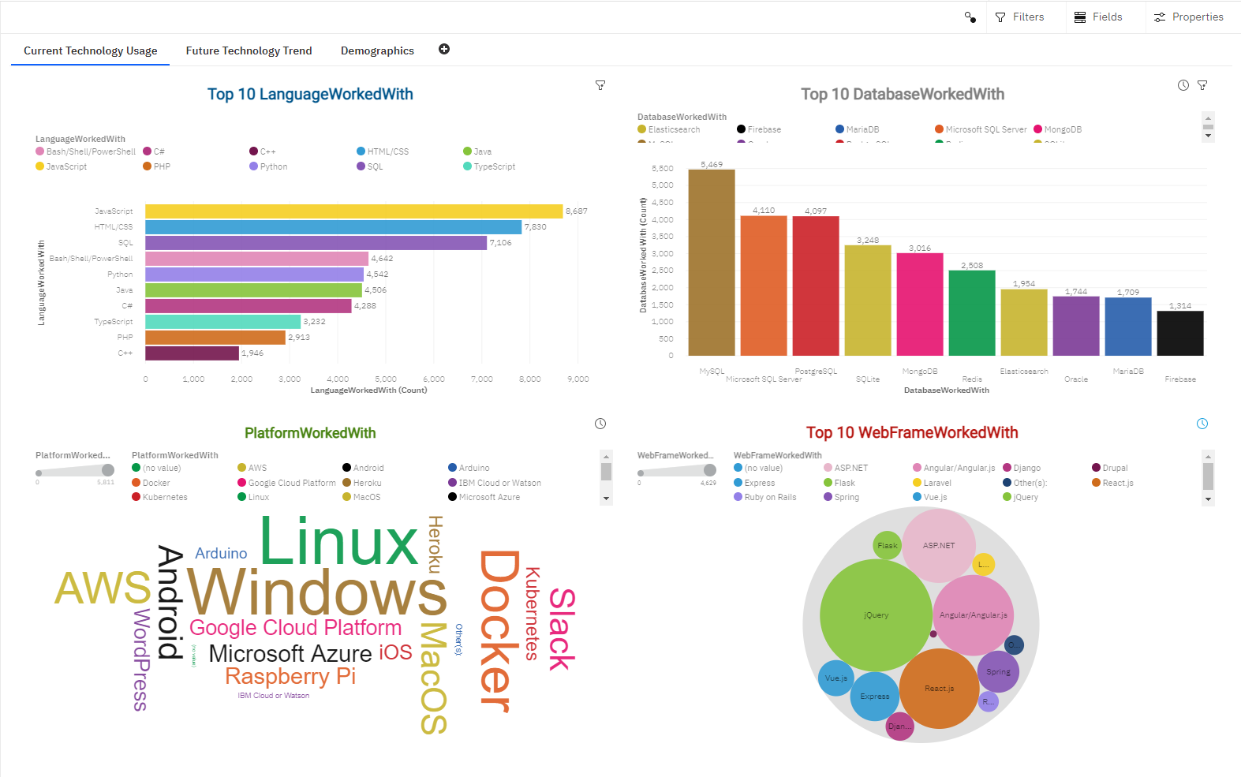
DASHBOARD TAB 1
Screenshot of dashboard tab 1 goes here

Slide 15
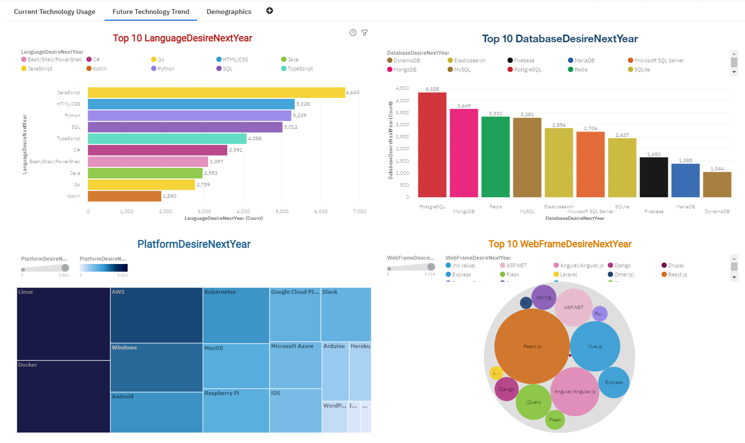
DASHBOARD TAB 2
Screenshot of dashboard tab 2 goes here

Slide 16
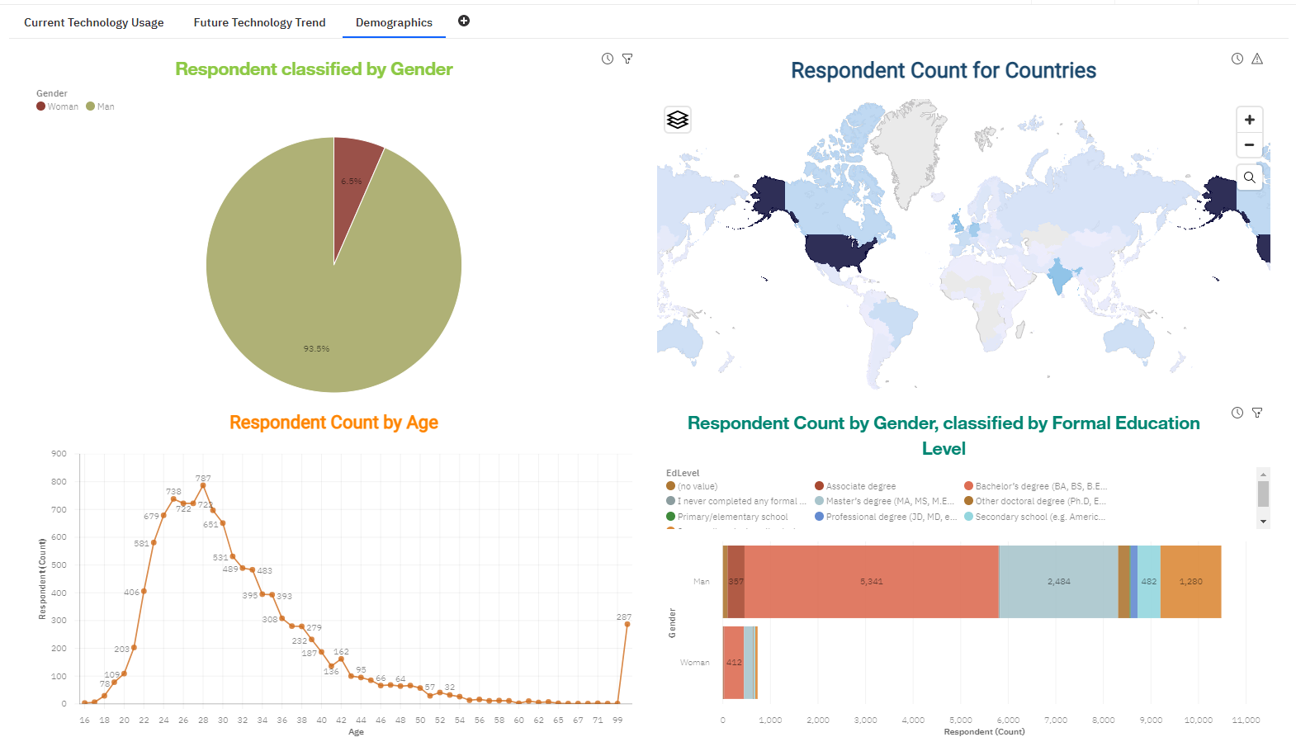
DASHBOARD TAB 3
Screenshot of dashboard tab 3 goes here

Slide 17
DISCUSSION
Technology Usage Trend Now and Future
Gender, Age and Education Discrimination in IT Industry

Slide 18
OVERALL FINDINGS & IMPLICATIONS
Findings
Technology trends changes every year
USA is the top technology country
There are extreme gender and age discrimination
Docker and AWS are the most popular platform
Implications
Programmers should always follow the latest technology trends
More countries should have the equal chance to be exposed to new technology
Gender and Age should not be one of the concerns or benefits of Employment

Slide 19

CONCLUSION
Technology Trends
Programming Languages, Database, Platform and Web frame Trends
Demographics Trends
Gender and Education
Programming Languages Trends and Salary Trends

Slide 20

APPENDIX
IBM Cognos Dashboard Embedded (CDE) is an AI-fueled business intelligence service that supports the entire data analytics cycle, from discovery to operationalization.
It provides users with data discovery capabilities to visually explore and interact with their data to identify the key insights for improving data driven decisions.
Users can perform data discovery and then quickly assemble that information into interactive, visually appealing dashboards; all without the need of formal training.

Slide 21
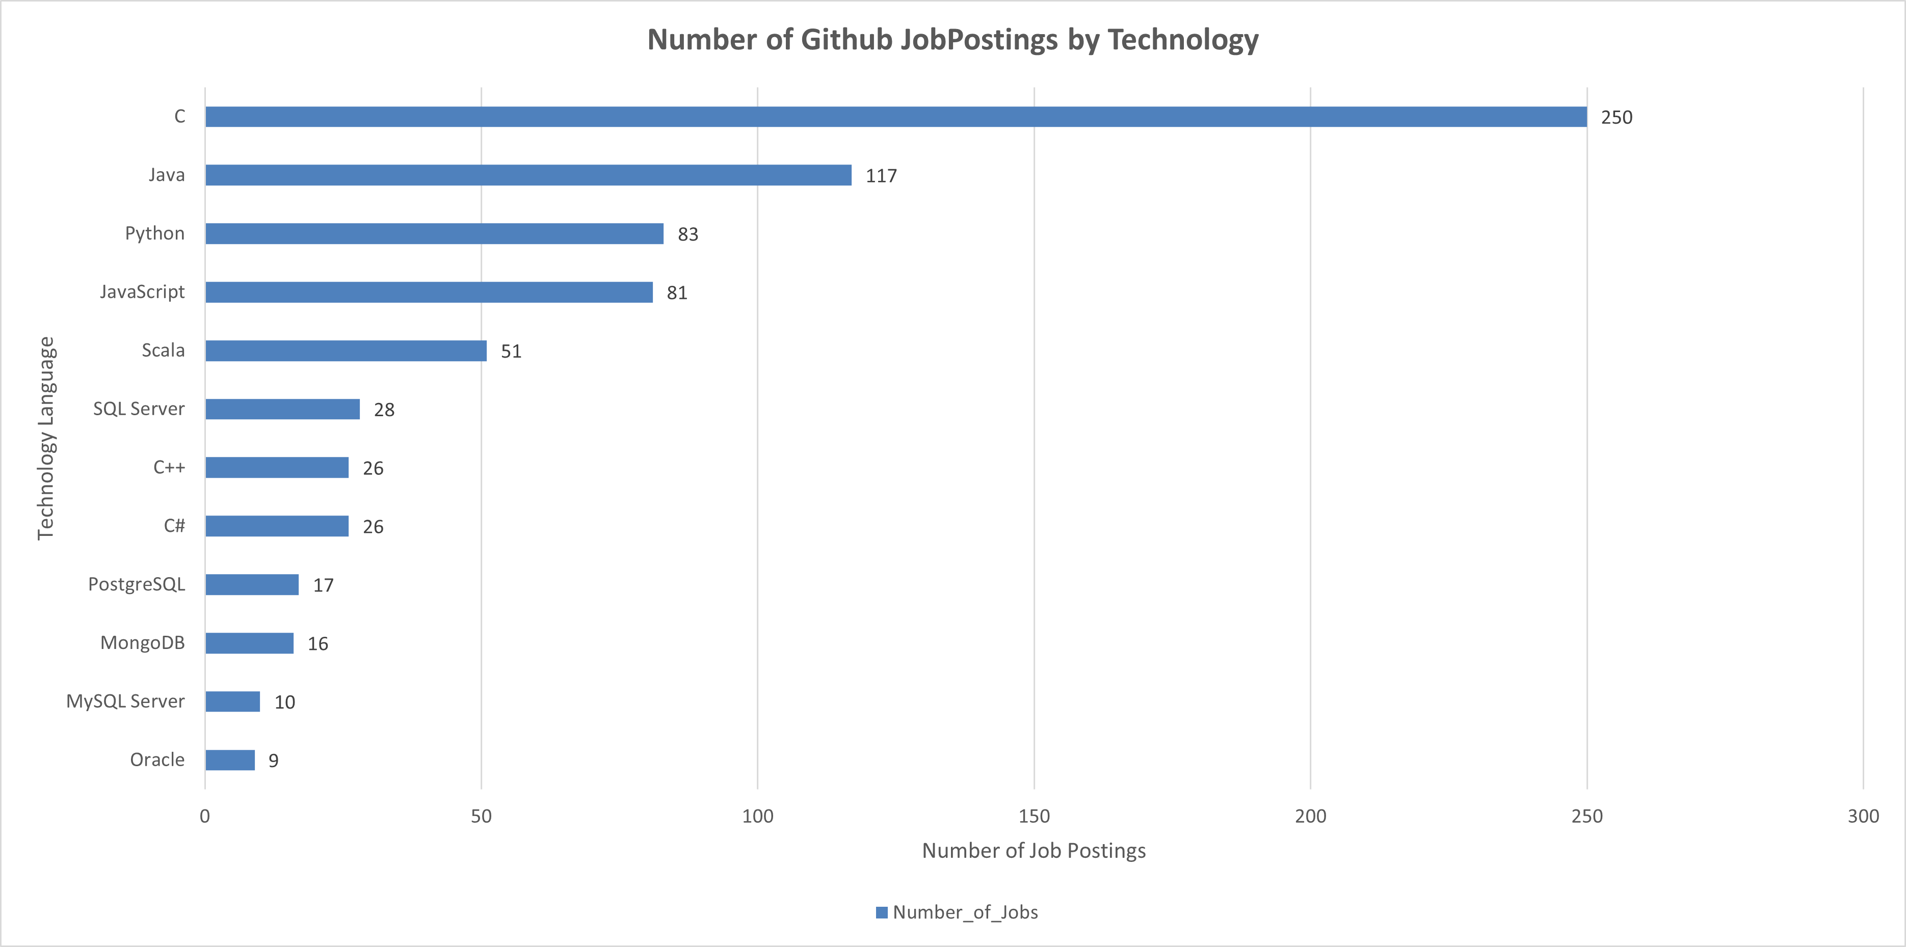
GITHUB JOB POSTINGS
In Module 1 you have collected the job postings data using GitHub API in a file named “github-job-postings.xlsx”. Present that data using a bar chart here. Order the bar chart in the descending order of number of job postings.

Slide 22
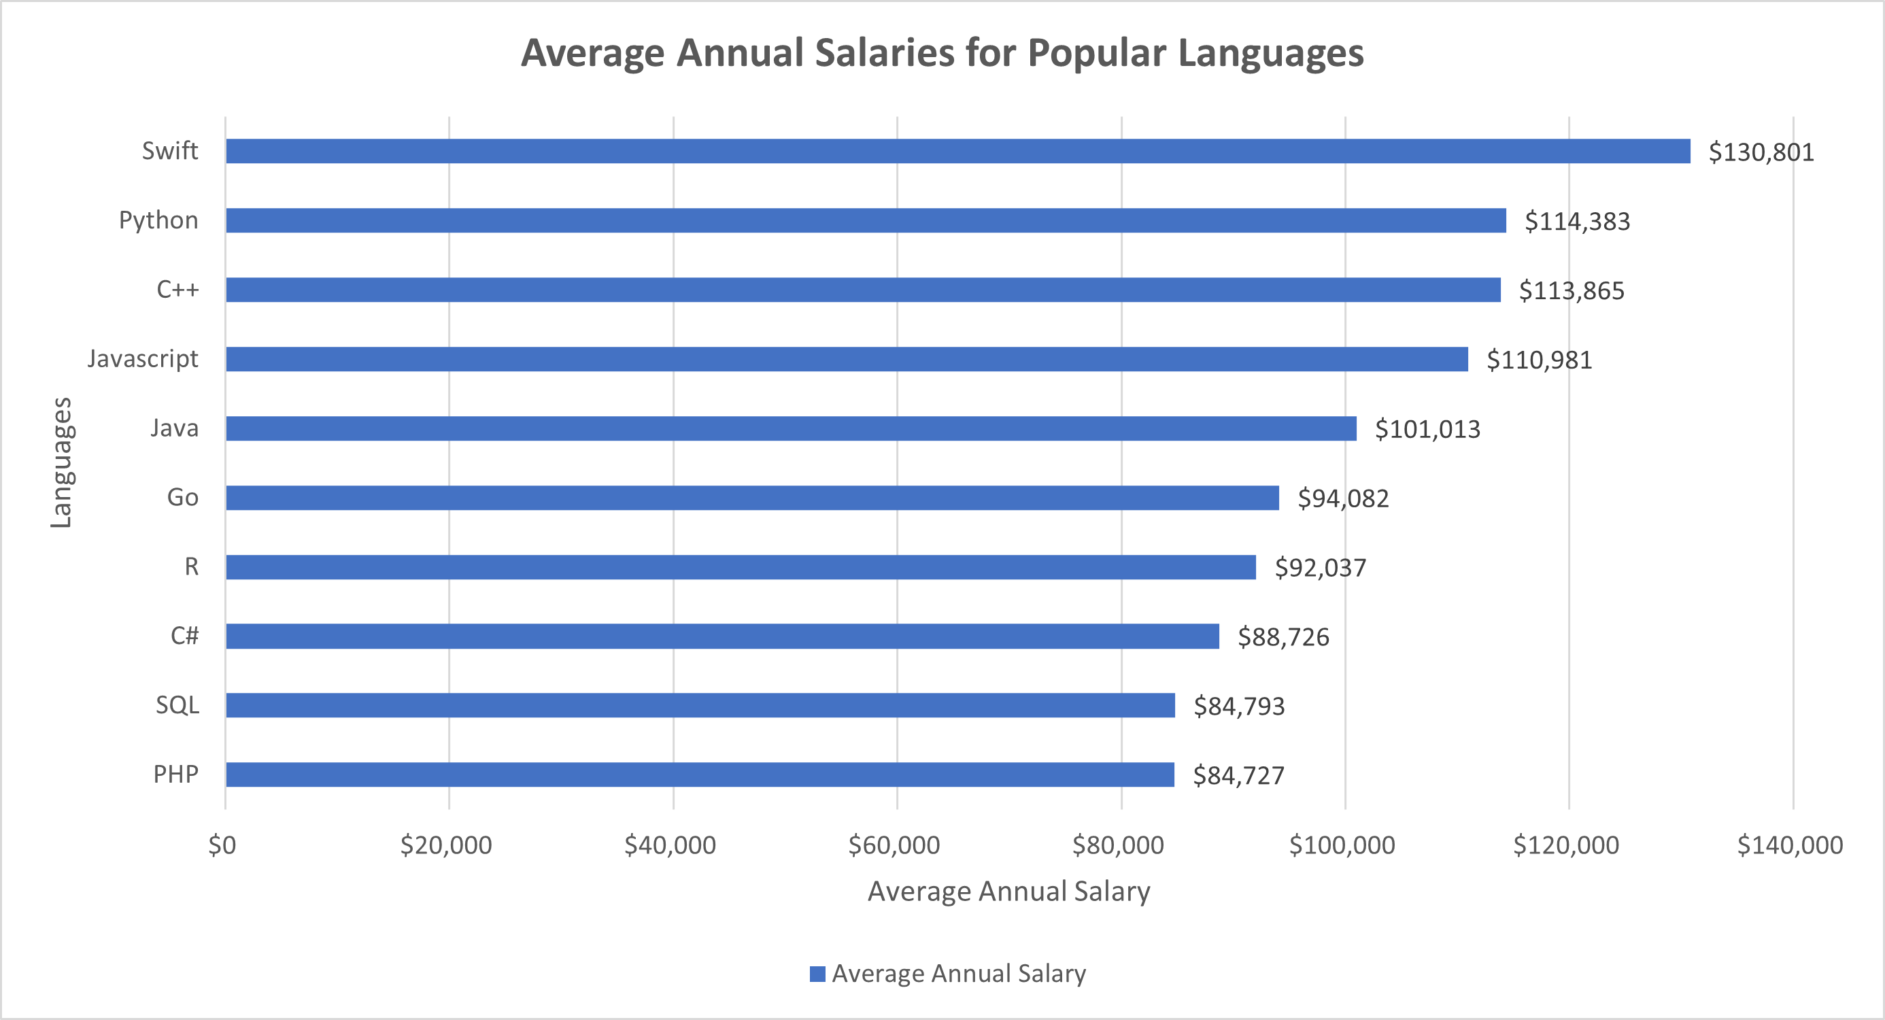
POPULAR LANGUAGES
In Module 1 you have collected the job postings data using web scraping in a file named “popular-languages.csv”. Present that data using a bar chart here. Order the bar chart in the descending order of salary.

